Slide 1
Business Economics Introduction & Tool Kit
ECON 431
Iowa State University
Darin Wohlgemuth

Slide 2
Economics
The study of the allocation of scarce resources to produce goods and services and to allocate them for consumption among competing and unlimited wants

Slide 3
Opportunity Cost
The value of the next best alternative use of a resource.

Slide 4
Review of Economic Terms
Resources
Factors of production or inputs
Land, labor, capital, entrepreneurship
Entrepreneurship is the willingness to take certain risks in the pursuit of goals.
(Keat & Young, Prentice Hall Business Publishing, 2003)

Slide 5
Profits & Corporate Social Responsibility
“There is one and only one social responsibility of business – to use its resources and engage in activities designed to increase its profit so long as it stays within the rules of the game, which is to say, engages in open and free competition without fraud or deception.”
Milton Friedman – Capitalism & Freedom, 1962
sited in Froeb & McCann, Managerial Economics, 2008

Slide 6
Profits
Accounting Profits: Revenues - Direct Costs
Economic Profits: Revenues - Direct Costs -
Opportunity Costs

Slide 7
Example: What is the Profit from your college degree?
Accounting Profit:
(Earnings w/ College - Earnings w HS)
- (Tuition+Books)
Economic Profit:
What is the Opportunity Cost of college?
(Earnings w/ College - Earnings w HS)
- (Tuition+Books)
- (Value of 4 yrs of foregone HS earnings)

Slide 8
Economics of Effective Management
Five Forces and Industry Profitability*
Entry
Entry Costs
Speed of Adjustment
Sunk Costs
Economies of Scale
Network Effects
Reputation
Switching Costs
Government Restraints
Power of
Input Suppliers
Supplier Concentration
Price/Productivity of Alternative Inputs
Relationship-Specific Investments
Supplier Switching Costs
Government Restraints
Level, Growth,
and Sustainability
of Industry Profits
Power of
Buyers
Buyer Concentration
Price/Value of Substitute Products or Services
Relationship-Specific Investments
Customer Switching Costs
Government Restraints
Industry Rivalry
Substitutes & Complements
Concentration
Price, Quantity, Quality,
or Service Competition
Degree of Differentiation
Switching Costs
Timing of Decisions
Information
Government Restraints
Price/Value of Surrogate Products or Services
Price/Value of Complementary Products or Services
Network Effects
Government Restraints

Slide 9
Accomplishing Goals
Best when rewards of managers and workers are directly linked to the goal.
Economic Model
A simplification of reality that models the key interactions and behaviors

Slide 10
Managerial Economics
Brings economic theory, empirical analysis together to help individuals direct scarce resources
to efficiently achieve goals

Slide 11
The Time Value of Money*
Present value (PV) of an amount (FV) to be received at the end of “n” periods when the per-period interest rate is “i”:
Notes:
You must know 2 of the three things in this eqn. IF you want to find the PV - you must know the amount and period of the future payment & the interest rate.
What is the value TODAY of 1 dollar 1 year from now?
Assume the rate of return is 10%.
PV = 1/(1+10%)^1=1/1.1 = 0.909
What is the present value of 1 dollar TWO years from now?
PV = 1/(1+10%)^2 = 1/1.1^2 = 0.826
What is the PV of 1 dollar 3 years from now?
PV = 1/(1+10%)^3 = 0.751
NOTE – We can do a little algebra and re-write this equation as the Future Value of some present sum of money that is invested at the rate i for n periods.

Slide 12
Present Value of a Series*
Present value of a stream of future amounts (FV_{t}) received at the end of each period for “n” periods:
Notes:
The future payments can be equal but are NOT required to be equal.

Slide 13
Annuity Value*
When the “Future Value” is the same in all periods, you can use the annuity tables/formula
Notes:
When using annuity values, the Future Payment is most often a constant amount.

Slide 14
Present Value of Benefits and Costs*
Present Value of Benefits
Present Value of Costs

Slide 15
Net Present Value*
Present Value of Benefits – Present Value of Costs

Slide 16
Internal Rate of Return*
What is the Interest Rate (i) at which the Net Present Value is 0?

Slide 17
Applications of PV & IRR
Powerball Lottery
Coffee & Lunch
Educational Investment

Slide 18
Identifying Goals & Constraints
Consumers: Max Utility (satisfaction) subject to a budget constraint
Workers: Max Utility subject to a time constraint
Firms: Max Profits subject to available technology and prices

Slide 19
Marginal Analysis*
The
ADDITIONAL
cost or benefit of 1 more unit.
(a.k.a. Marginal Benefit & Marginal Cost.)

Slide 20
Marginal Principle*
MB > MC means the last unit of the control variable increased benefits more than it increased costs
MB < MC means the last unit of the control variable increased costs more than it increased benefits
To maximize net benefits, the managerial control variable should be increased up to the point where MB = MC

Slide 21
The Geometry of Optimization*
Costs
Benefits & Costs
Benefits
Slope =MB
B
Slope = MC
C
Q*
Q

Slide 22

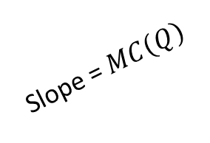
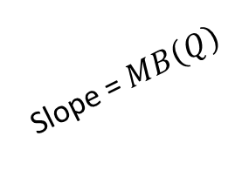

Economics of Effective Management
Determining the Optimal Level of a Control Variable*
Total benefits
Total costs
Maximum total benefits
$$C\left(Q\right)$$
Slope = $MB\left(Q\right)$
$$B\left(Q\right)$$
Maximum net
benefits
Slope = $MC\left(Q\right)$
0
Quantity
(Control Variable)

Slide 23


Determining the Optimal Level of a Control Variable II*
Economics of Effective Management
Net benefits
Maximum
net benefits
Slope =$MNB(Q)$
0
Quantity
(Control Variable)
$$N\left(Q\right)=B\left(Q\right)−C\left(Q\right)=0$$

Slide 24



Economics of Effective Management
Determining the Optimal Level of a Control Variable III*
Marginal
benefits, costs
and net benefits
Maximum net
benefits
$$MC\left(Q\right)$$
0
Quantity
(Control Variable)
$$MNB\left(Q\right)$$
$$MB\left(Q\right)$$

Slide 25
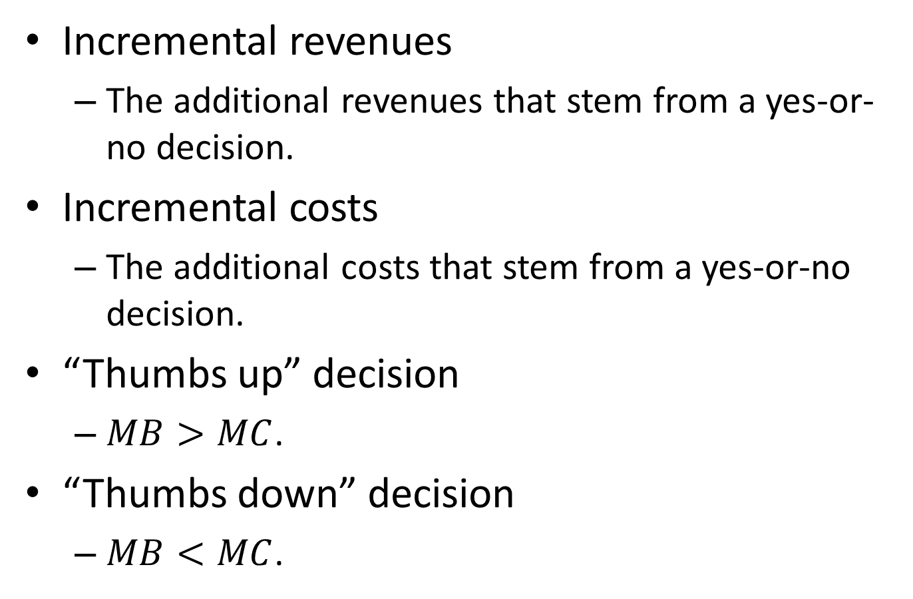
Economics of Effective Management
Incremental Decisions*
Incremental revenues
The additional revenues that stem from a yes-or-no decision.
Incremental costs
The additional costs that stem from a yes-or-no decision.
“Thumbs up” decision
$MB>MC$.
“Thumbs down” decision
$MB<MC$.

Slide 26
Questions on Find the Slope?

Slide 27
* indicates slides that were included in the instructors resources from Baye, Managerial Economics & Business Strategies.

